Slide 1
Lending Club Case Study
EDA with Python

Slide 2
Problem Statement
Holder text for the problem statement

Slide 3
Analysis approach
Description - analysis approach

Slide 4
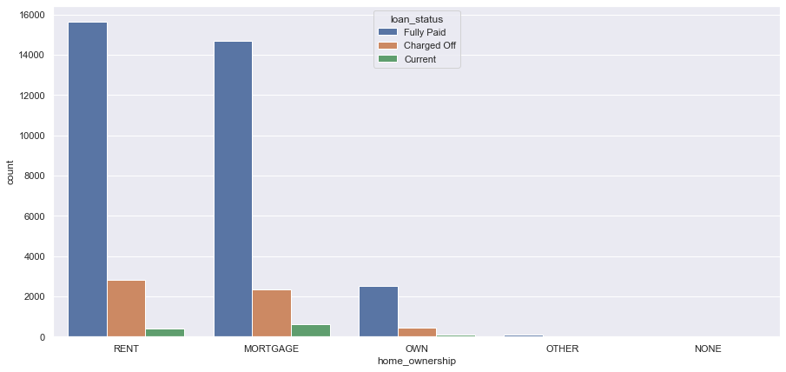
Univariate Analysis

Slide 5
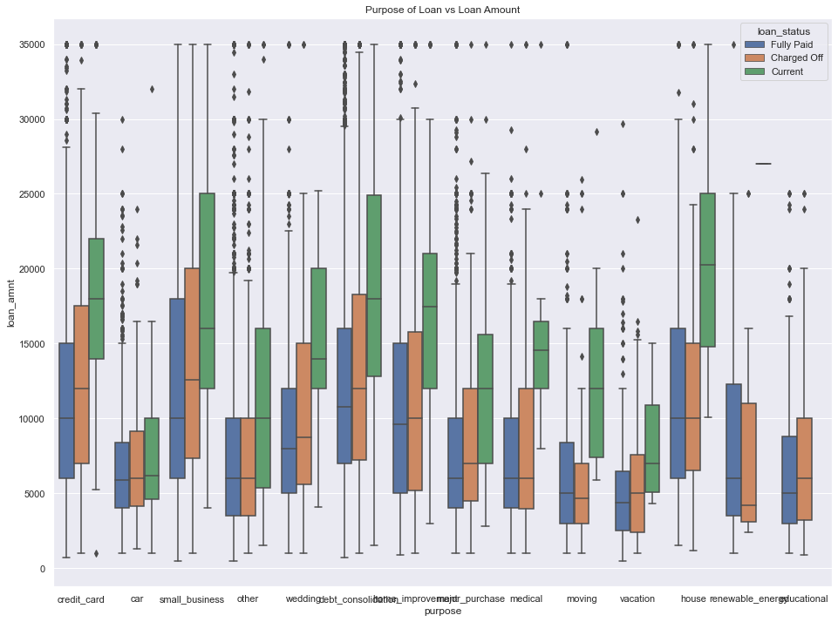
Bivariate Analysis

Slide 6
Conclusions and Results

